Slide 1

Starter Task
Login to a computer (might take a while)
Sign into Glow then open Teams

Slide 2
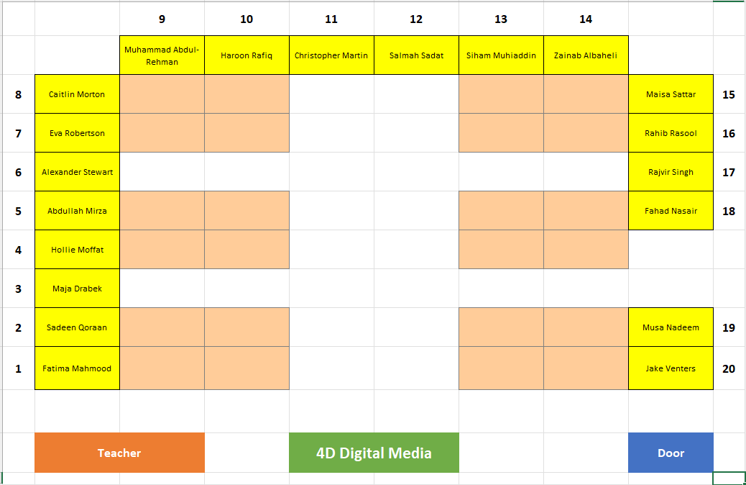

Slide 3
Learning intentions and success criteria
I am learning…
I can…
Still image editing terms
How to use editing to change the look of an image
Identify and define still image editing terms
Edit still images using PhotoPlus

Slide 4

Editing Still Images
NPA Digital Media

Slide 5
Level 5 Assessment Brief
The theme is a day in the life of a pupil, You are to acquire at least:
10 photographs, one of which should contain a person
8 audio clips
6 moving images
The media elements should cover a range of stills, audio and moving images to show what a typical day in your life is like, for example, traffic, playing games, walking or what you do at home.
This is to be presented either as a presentation, blog, website or a movie.

Slide 6
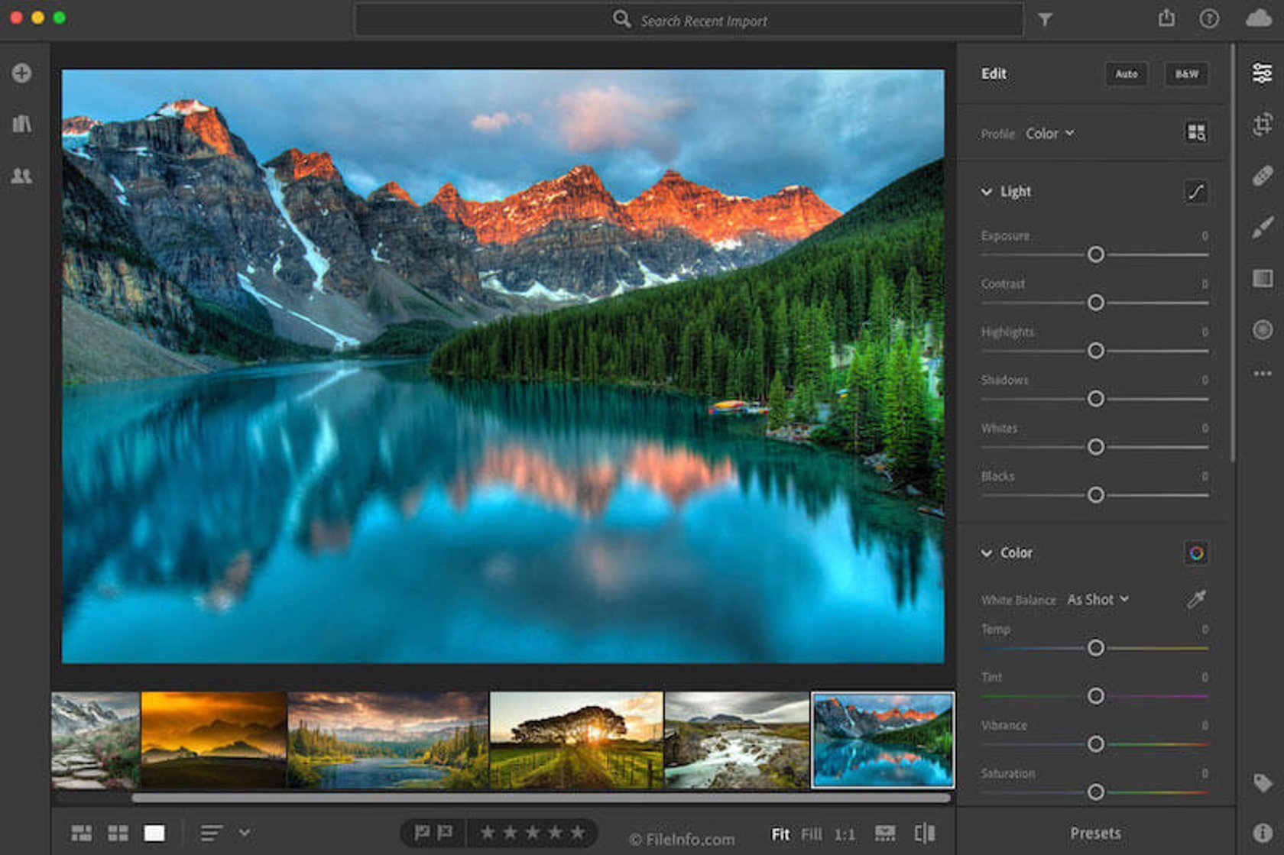
Editing Terms
Today we will cover a variety of still image editing terms:
You will use these when producing your portfolio
At least six of your ten images must be edited
You need to explain what edits you made to the image

Slide 7
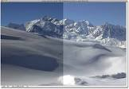

Brightness/Contrast
Gamma:
A measure of the brightness and contrast of an image
Brightness:
The amount or intensity of light
Contrast:
The difference between the darkest and lightest areas in an image

Slide 8
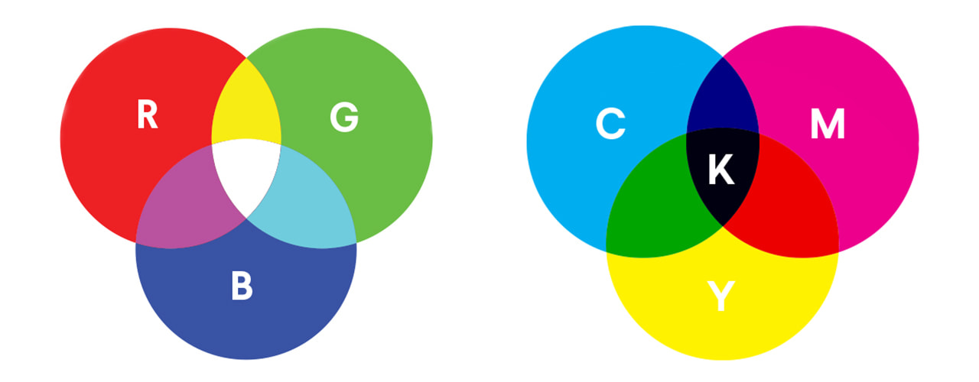
Colour Models
RGB:
Red, Green and Blue. The three primary colours used to make a colour image
CYMK:
Cyan Magenta Yellow and Key (usually black). The colours of inks used in printers

Slide 9
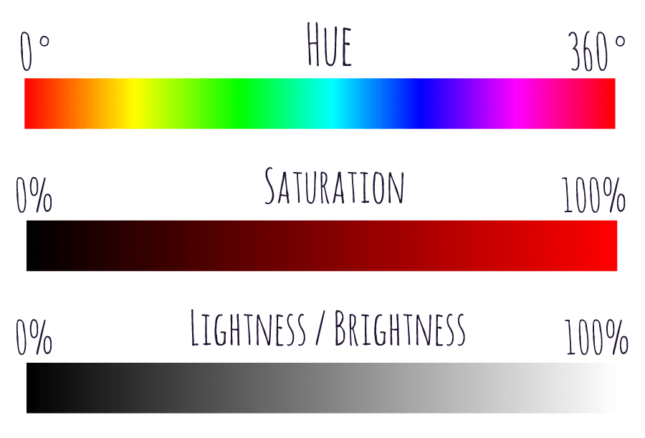
Colour
Hue:
The visual perception of colour – the actual colour
Saturation:
The amount of colour in a photo – the intensity of the colour

Slide 10
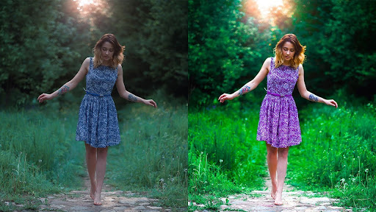
Colour
Colour correction:
Technique used to improve or correct the colour of an image
Red eye:
The reflection of a camera’s flash from the back of a subject’s eye

Slide 11
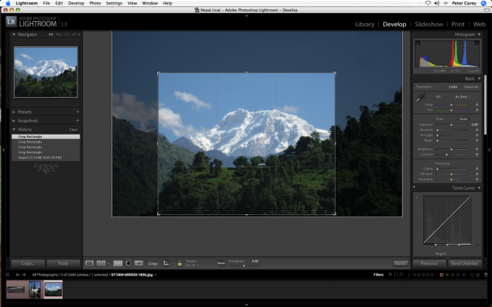
Image Size
Crop:
To remove unwanted parts of an image
Scale:
Reduce / increase the size of an image but keep the aspect ratio the same

Slide 12
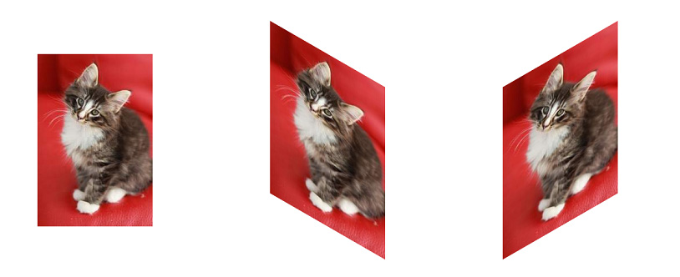
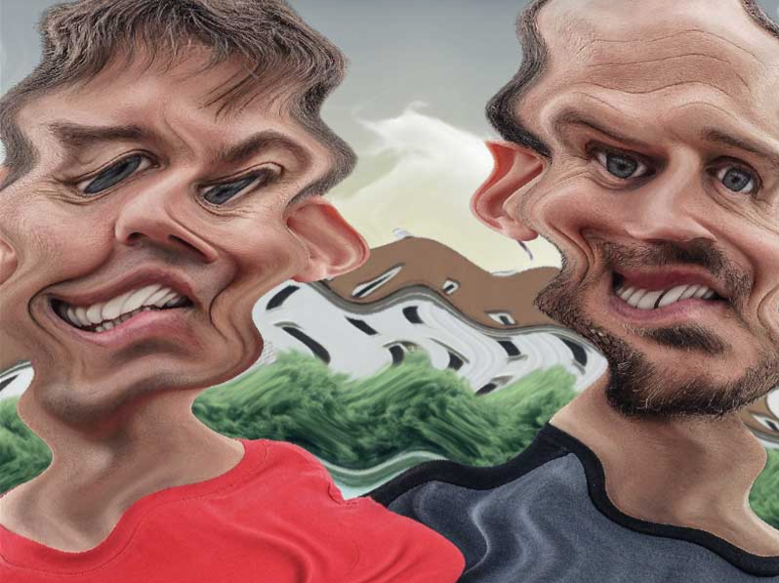
Image Perspective
Skew:
To apply a horizontal or vertical slant to an image
Rotate:
Turn the image at an angle
Distort:
An abnormality in image quality such as stretching the image

Slide 13
Learning intentions and success criteria
I am learning…
I can…
Still image editing terms
How to use editing to change the look of an image
Identify and define still image editing terms
Edit still images using PhotoPlus

